Slide 1

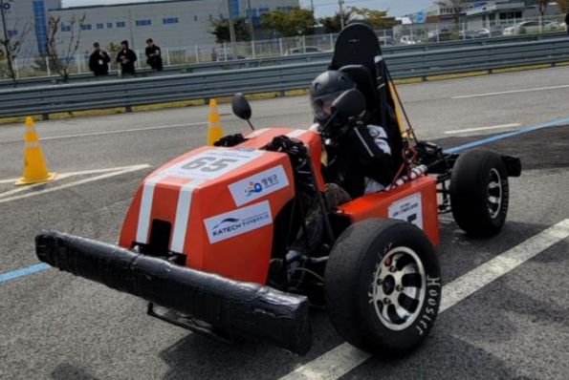
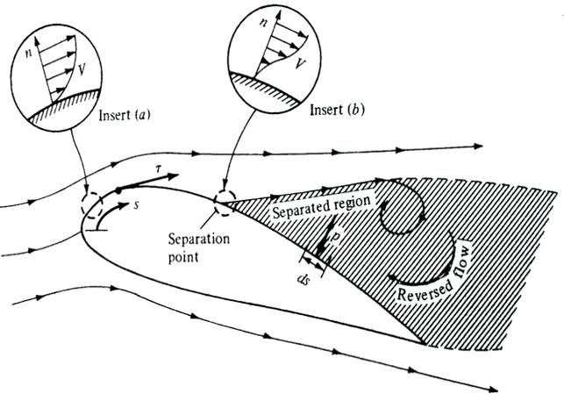
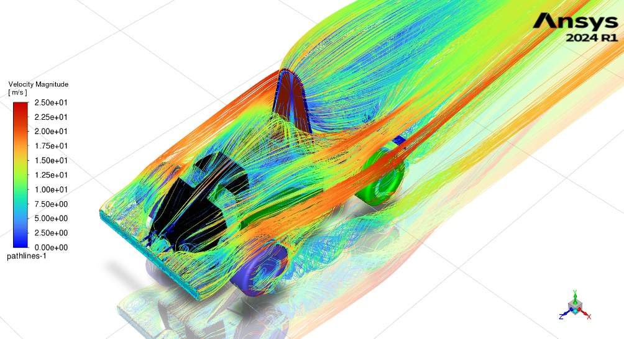
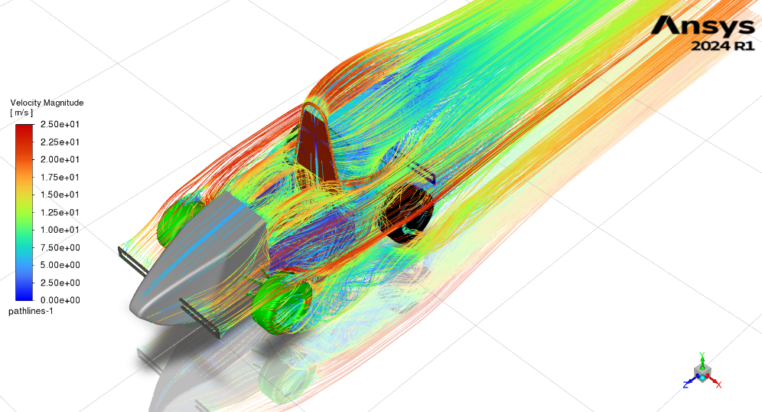
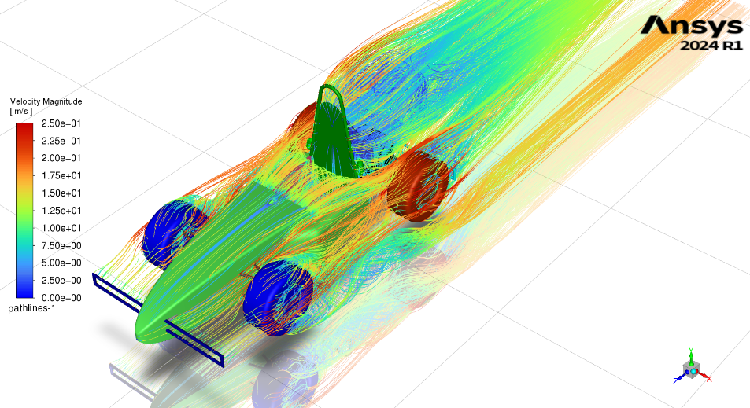
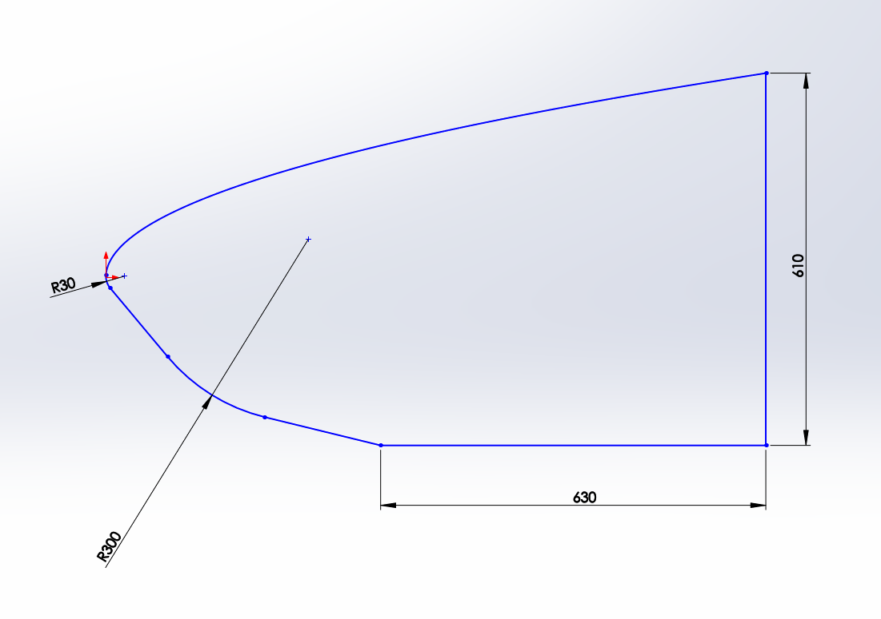
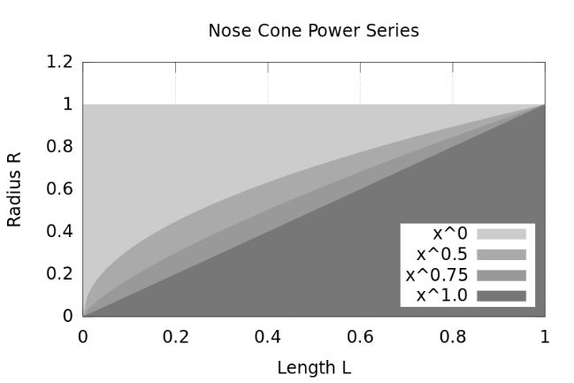
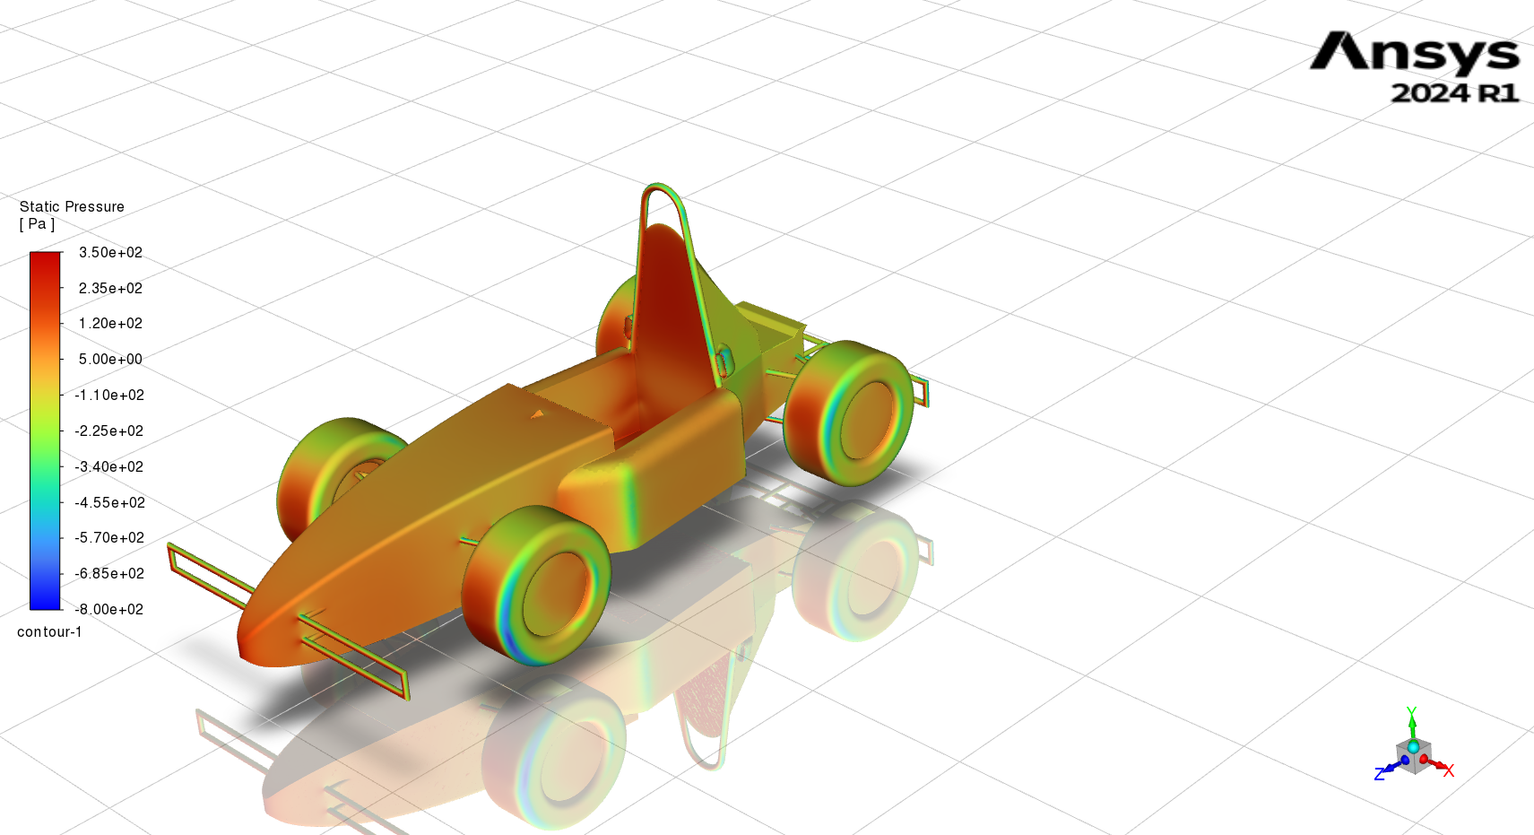
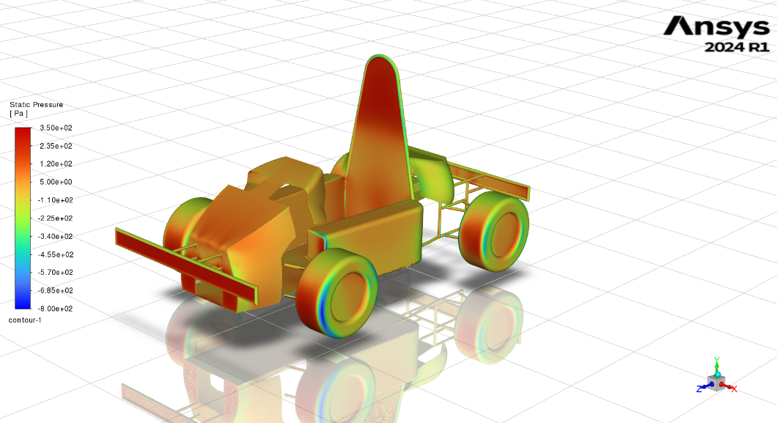
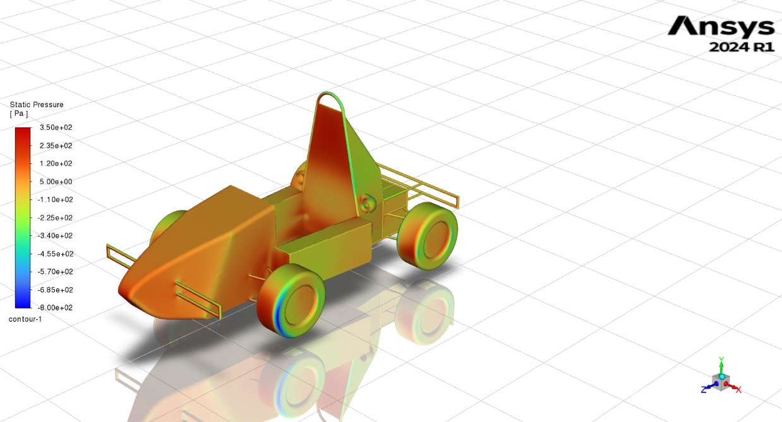
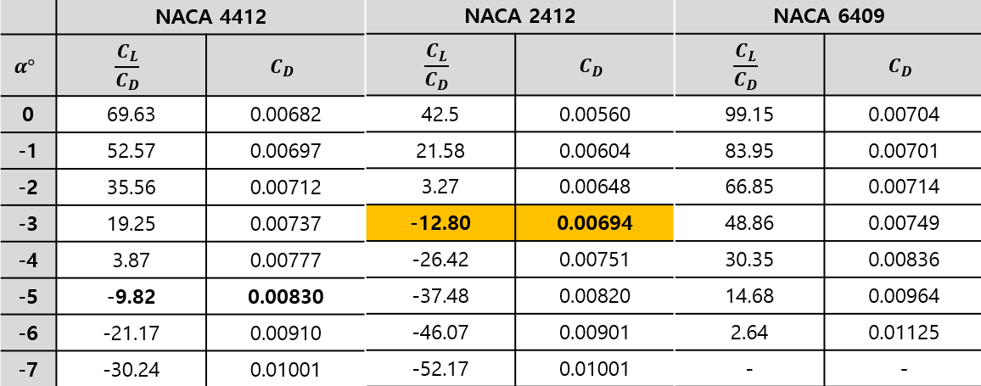
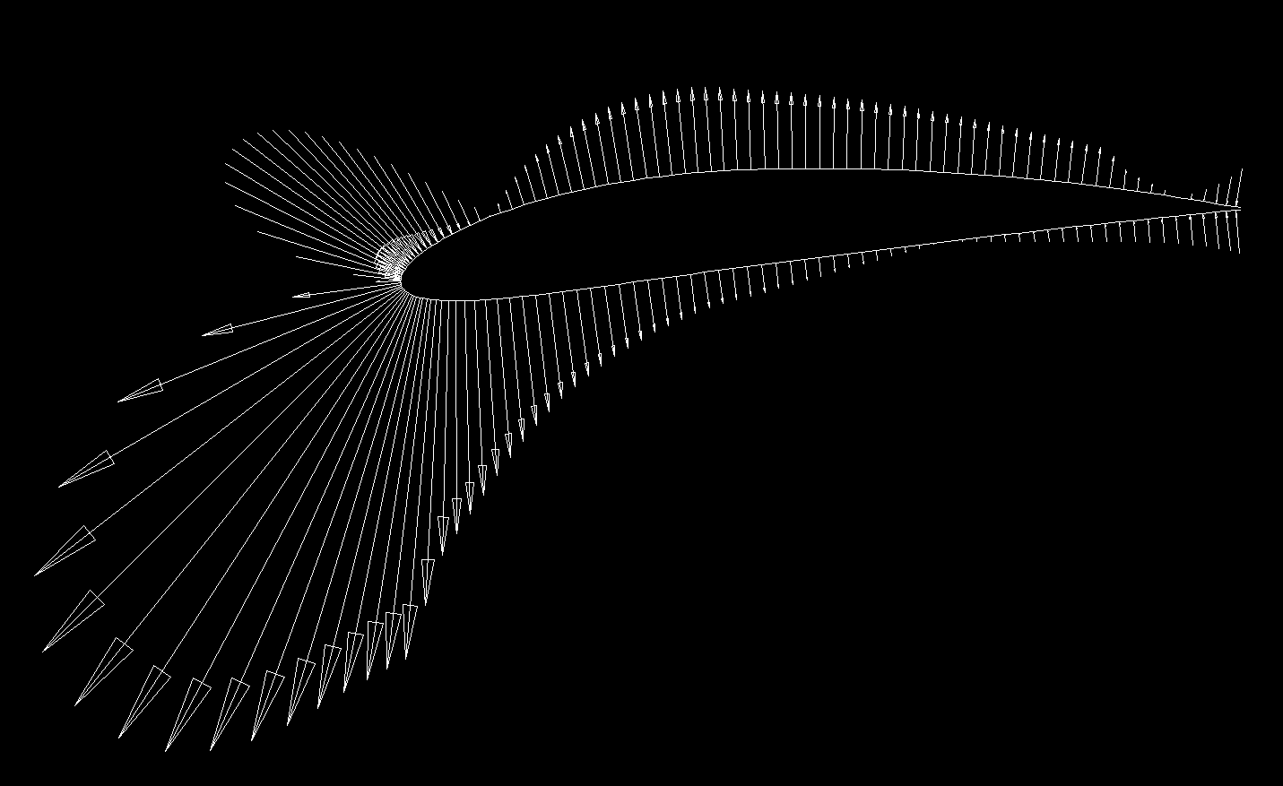
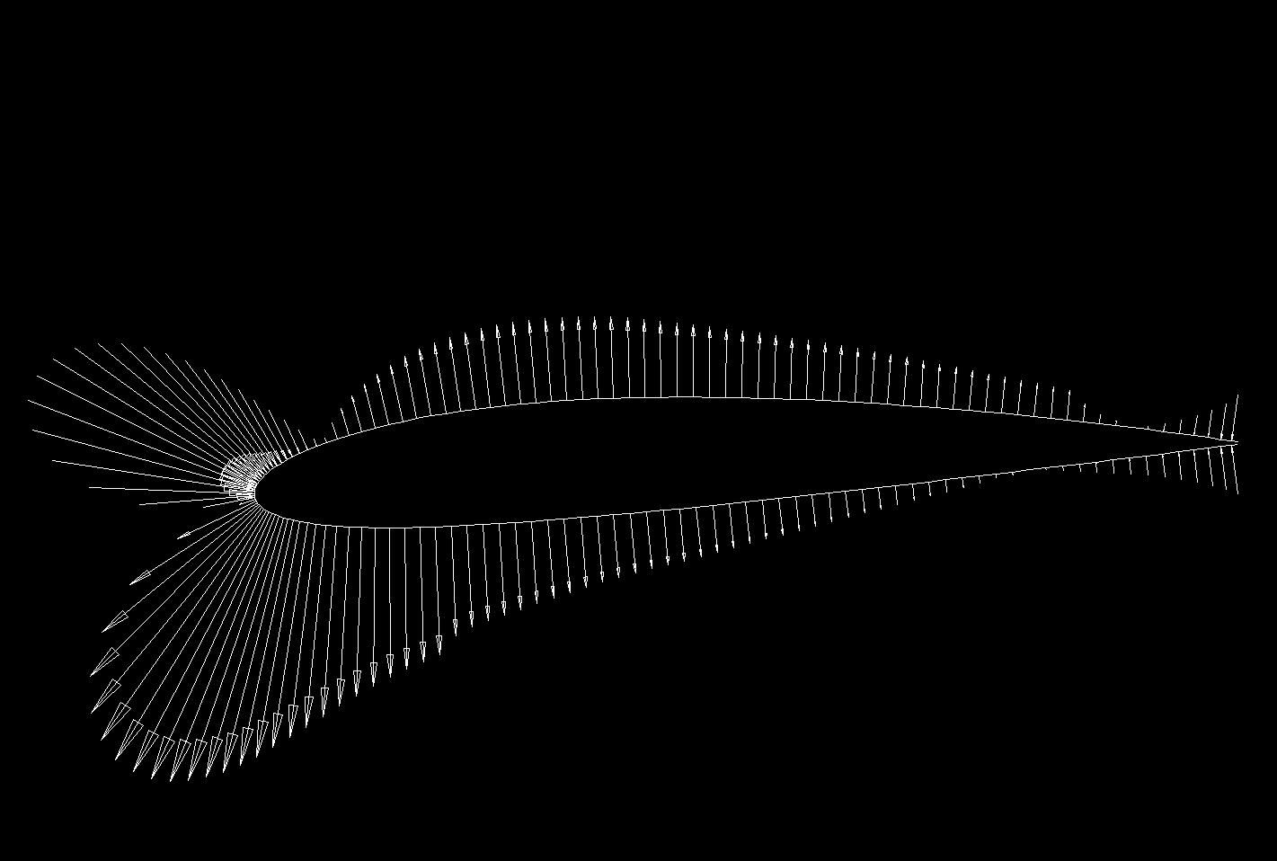
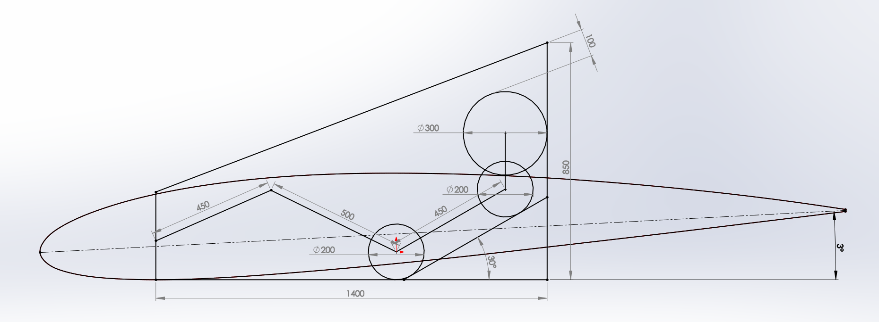
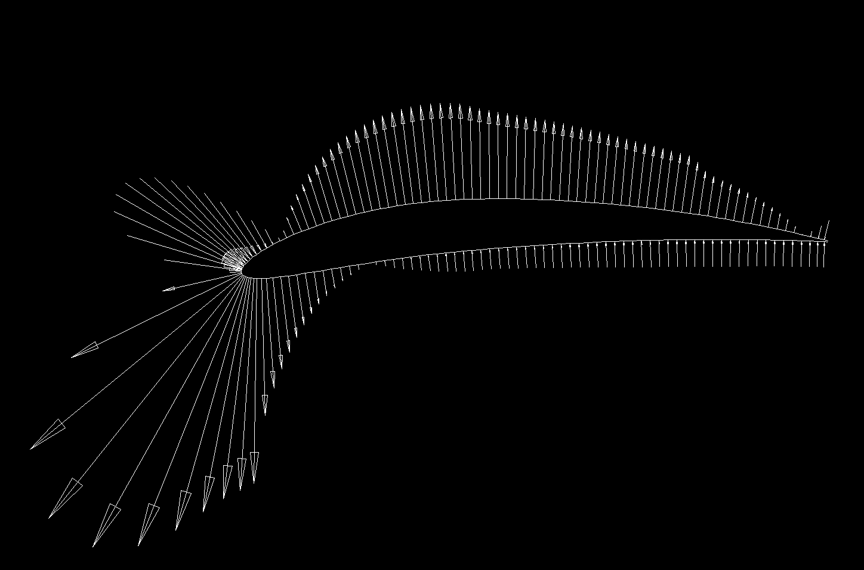
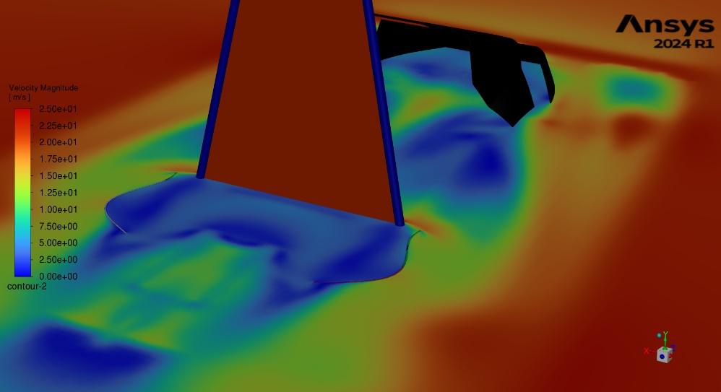
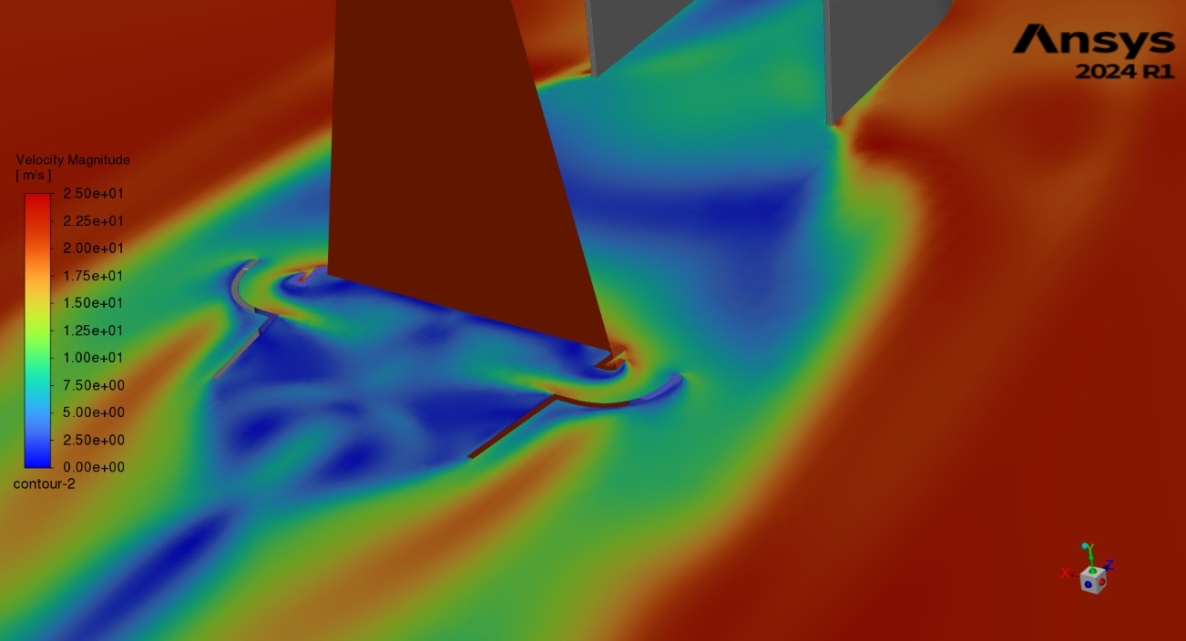
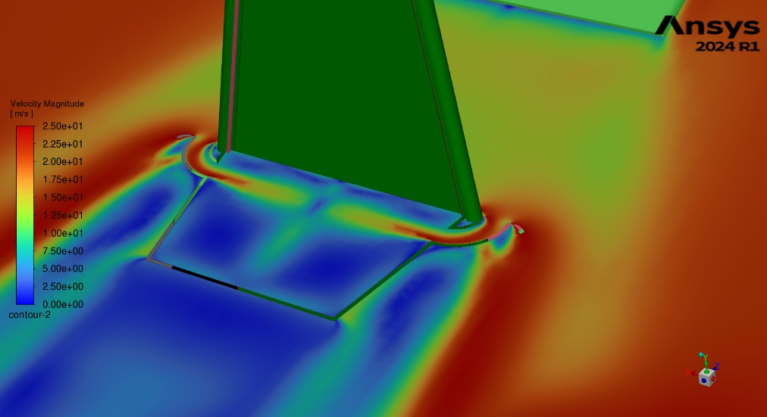
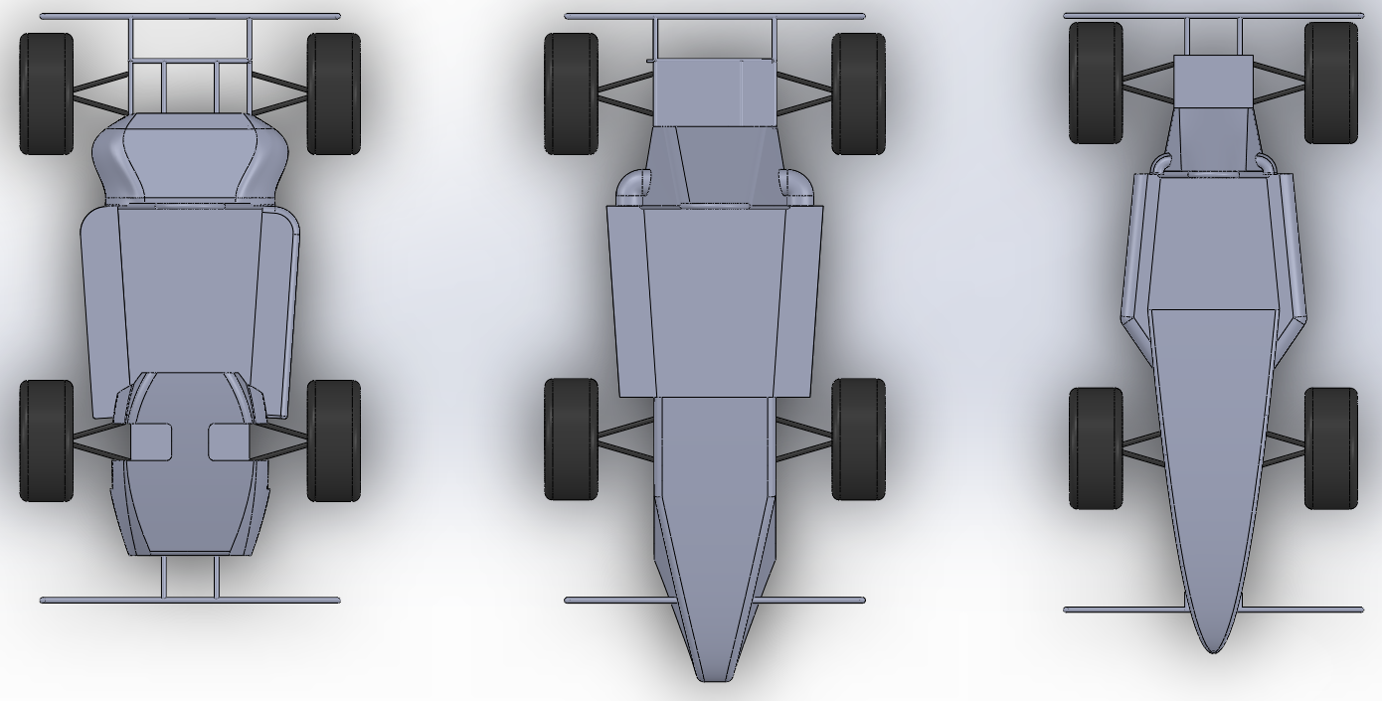
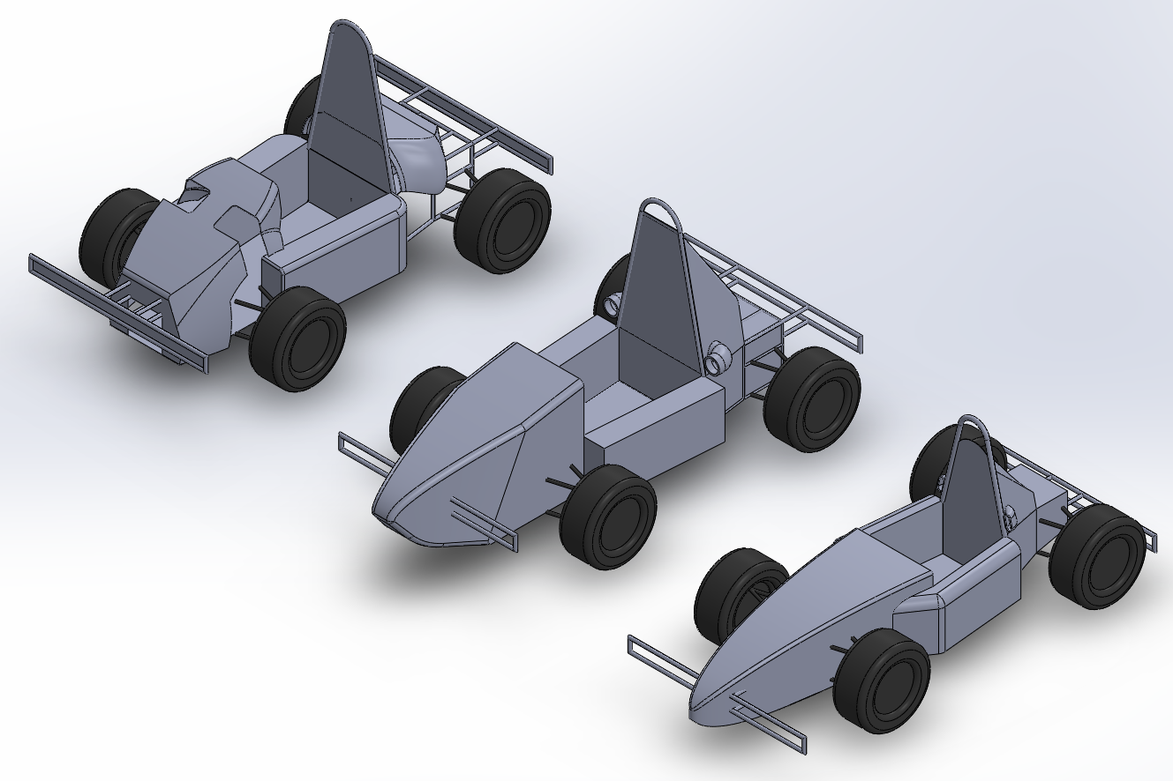
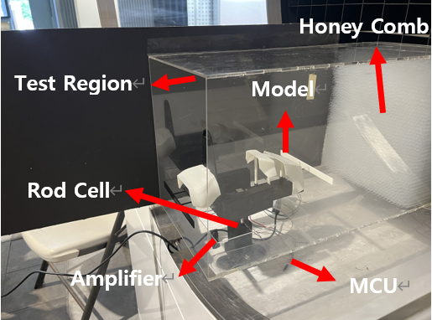
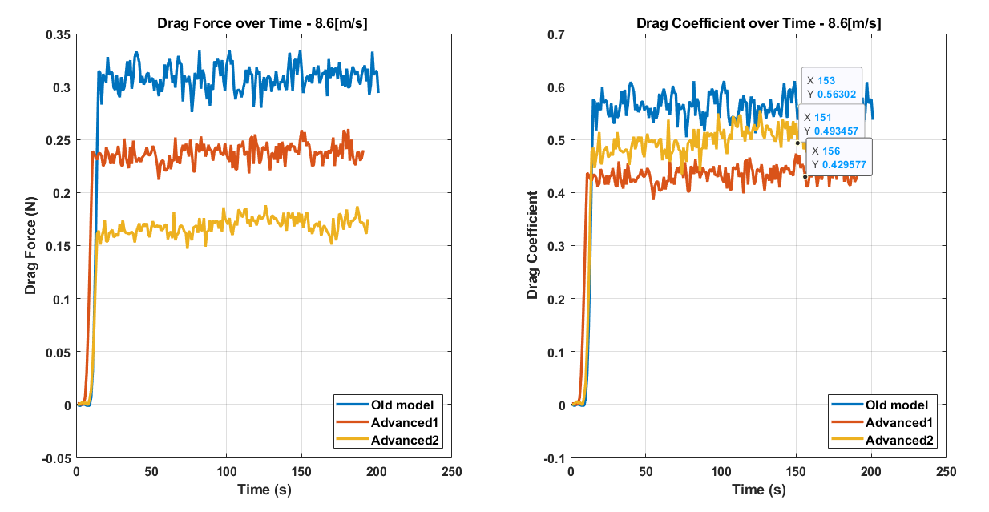
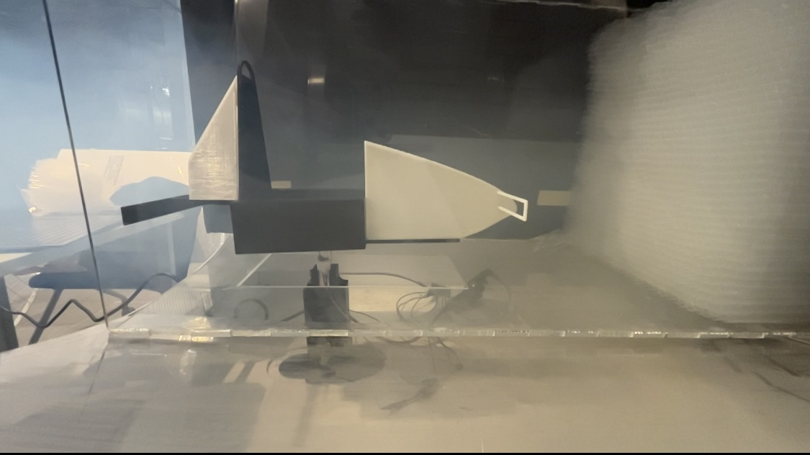
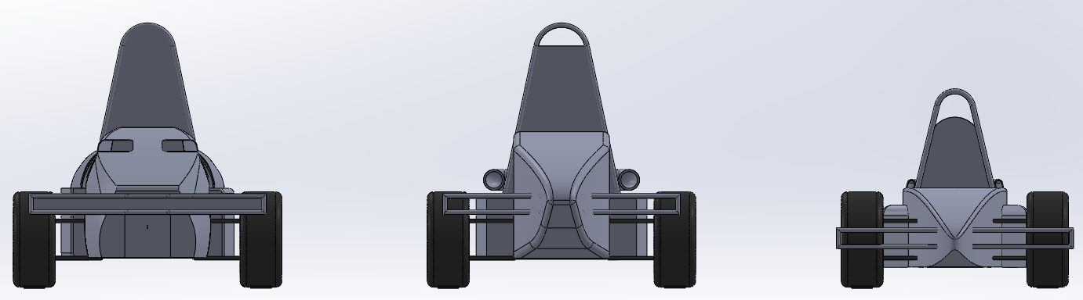
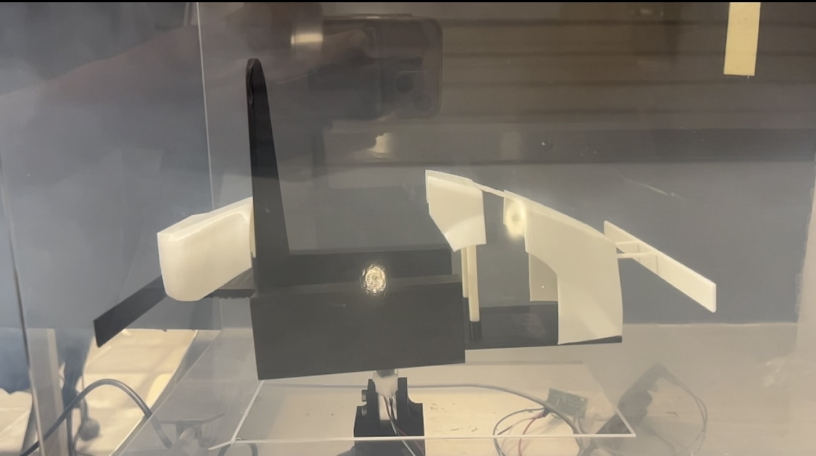
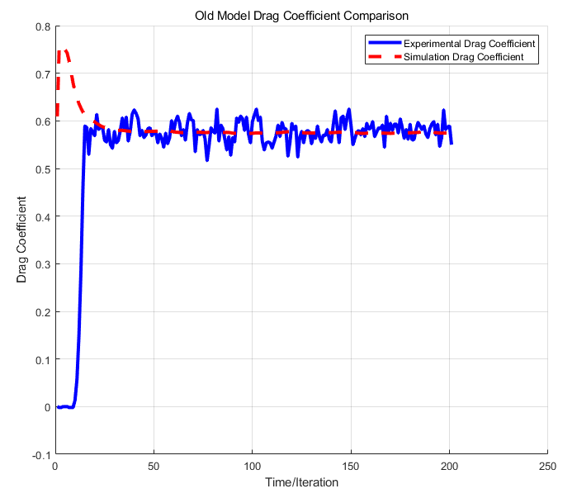
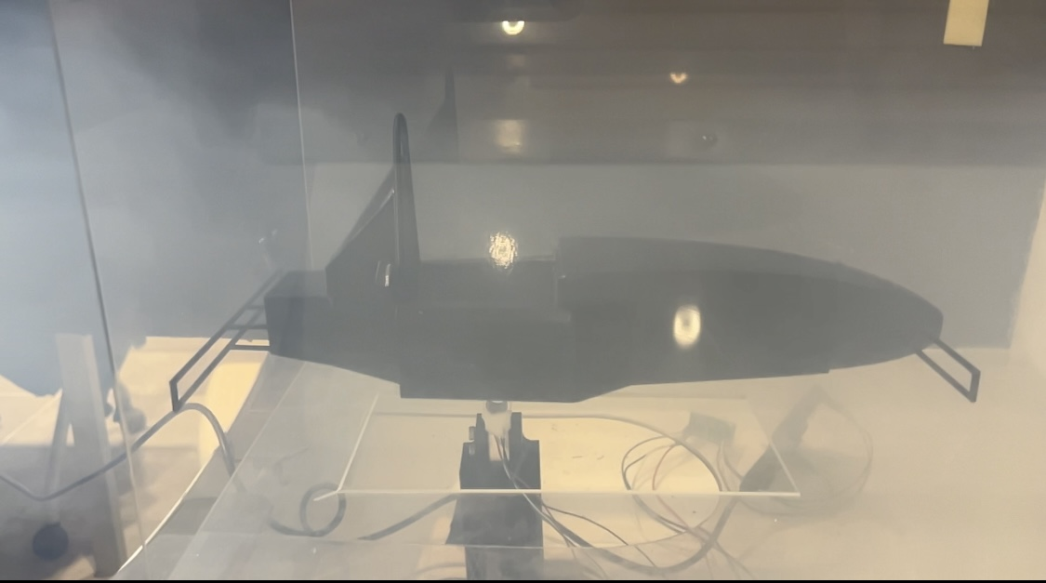
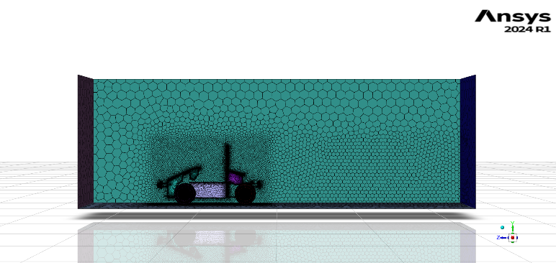
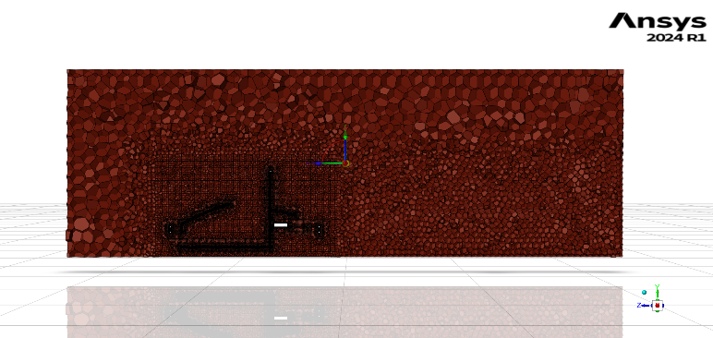
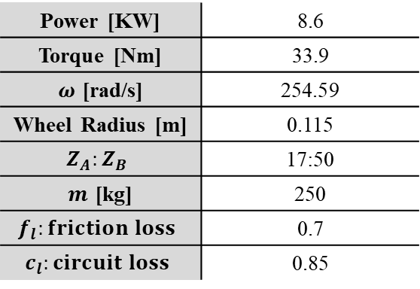
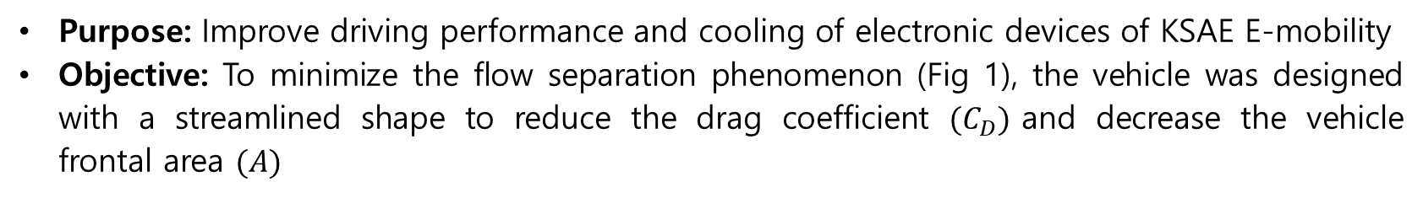
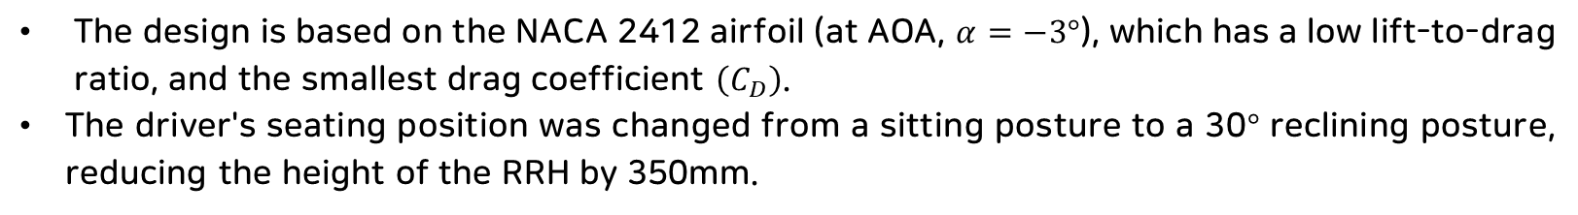
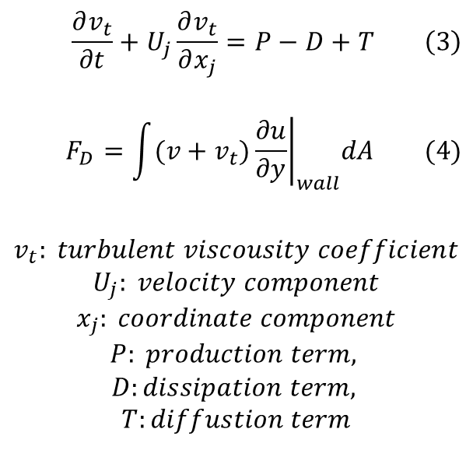
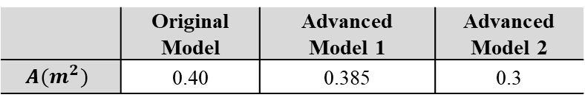
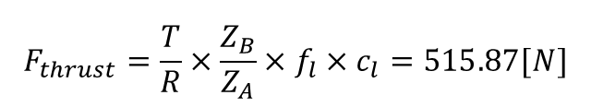
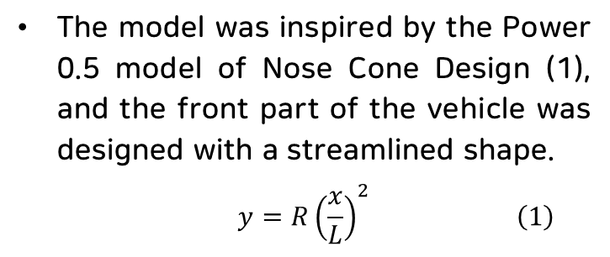
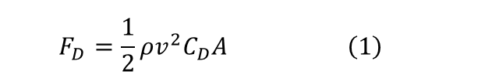
Optimal Design for Improving Drag and Cooling Performance of
KSAE E-Mobility through CFD Analysis
G. H. An, C. S. LEE
Handong Global University Mechanical Control Engineering
Introduction
Turbulence Model & Boundary Conditions
Used Turbulence Model: Spalart-Allmaras (1-eqn)
Single Transport Equation -(3)
Suitable for External Boundary Layer Flow Analysis
Low Computational Cost
$$\frac{∂v_{t}}{∂t}+U_{j}\frac{∂v_{t}}{∂x_{j}}=P−D+T \left(3\right)$$
$$F_{D}=\int{{(v+v_{t})\left.\frac{∂u}{∂y}\right|}_{wall}dA (4)}$$
$$v_{t}: turbulent viscousity coefficient$$
$$U_{j}: velocity component$$
$$x_{j}: coordinate component$$
$$P: production term,$$
$$D:dissipation term,$$
$$T:diffustion term$$
Table 4. Boundary Conditions used in CFD Simulation
Type | Condition | Speed
Inlet | Velocity-Inlet | 20 [m/s]
Outlet | Pressure-Outlet | -
Cowl | Stationary-Wall | -
Frame | Stationary-Wall | -
Wheel | Rotational | 87.489 [rad/s]
Ground | Translational | -20 [m/s]
Tunnel-Wall | No Shear | -
Fig 1. Separation Phenomenon
$$F_{D}=\frac{1}{2}ρv^{2}C_{D}A \left(1\right)$$
Purpose: Improve driving performance and cooling of electronic devices of KSAE E-mobility
Objective: To minimize the flow separation phenomenon (Fig 1), the vehicle was designed with a streamlined shape to reduce the drag coefficient $(C_{D})$and decrease the vehicle frontal area $(A)$
CFD Result (Drag Force)
Model Description
Advanced 1 (Frame Unmodified)
The model was inspired by the Power 0.5 model of Nose Cone Design (1), and the front part of the vehicle was designed with a streamlined shape.
$$y=R{\left(\frac{x}{L}\right)}^{2} \left(1\right)$$
Fig 2. Power 0.5 Nose Cone Design
Advanced 2 (Frame Modified)
Table 1. Lift-to-Drag Ratio and Drag Coefficient of NACA Airfoil at Different Angles of Attack
Fig 9. Velocity pathlines and Pressure Contour of Models
Drag force reduced by 21.1% for Advanced 1 model and by 43% for Advanced 2 model.
Drag Coefficient reduced by 17.7% and 21%.
RRH(Rear Roll Hoop) and front wheels caused the most drag, due to vortices in rear area.
Streamlined design for advanced models reduced the drag coefficient.
Reduced frontal area mostly contributed to reduction of drag force.
Air vent drag did not significantly impact overall drag.
Fig 3. NACA 4412 $(α=−6°)$(XFOIL)
NACA 2412
Driver
RRH
Fig 4. NACA 2412 $(α=−3°)$(XFOIL)
Fig 10. Drag Force and Drag Coefficient
CFD Result (Cooling)
Fig 6. Advanced 2 Model Sketch (NACA 2412)
Fig 5. NACA 4412 $(α=−3°)$(XFOIL)
The design is based on the NACA 2412 airfoil (at AOA, $α=−3°$), which has a low lift-to-drag ratio, and the smallest drag coefficient $\left(C_{D}\right)$.
The driver's seating position was changed from a sitting posture to a 30$°$ reclining posture, reducing the height of the RRH by 350mm.
Electronic device
Electronic device
Electronic device
Fig 11. Rear Cowl Velocity Contour (Original, Advanced 1, Advanced 2)
Model Comparison
By adding an air vent shape, fast-flowing fluid through a narrow passage cools the electronic device with lower temperature fluid. ($2.5m/s→10m/s→16m/s)$
Fig 5. Original, Advanced 1, Advanced 2 Models (Up view)
Wind Tunnel Experiment
2194mm
2513mm
2426mm
Air Vent
Original Model
Advanced Model 1
Original Model
Advanced Model 1
Advanced Model 2
Advanced Model 1
Advanced Model 2
Table 2. Projected Area of Models
Original Model
Advanced Model 2
Fig 16. Drag Force & Drag Coefficient (8.6[m/s])
Original Model
Advanced Model 1
Advanced Model 2
 | Original Model | Advanced Model 1 | Advanced Model 2
$$A(m^{2})$$ | 0.40 | 0.385 | 0.3
Meshing Method
Table 3. Mesh Conditions
Fig 12. Wind Tunnel Experiment
Fig 13. Comparison of Experimental and Simulation Results
Region | Type | Size (mm)
BOI-nearfield | Body of Influence | 40
BOI-farfield | Body of Influence | 90
Bumper and Rods | Curvature | Min:4 / Max:5
Cowl | Curvature | Min:5 / Max:30
Wheel | Curvature | Min:3.5 / Max: 5
Boundary Layer | Last-ratio | 10 layers / Ratio: 0.2
Surface | Curvature & Proximity | Min: 0.5 / Max: 256
Volume | Poly-hexcore | Min: 0.5 / Max: 512
Discussion & Conclusion
z
Table 5. DIY Car Spec Sheet
The reduced drag (105[N]) is significant compared to the traction force of the vehicle (515.87[N]) in Table 5.
Reducing the projected area and drag coefficient resulted in decreased drag force.
Reduced drag can improve top speed and acceleration.
Safety device (RRH) regulations limited drag force reduction up to 43%.
Adding air vents improved cooling and motor efficiency.
Simulation time: 90min. Proper geometry and mesh generation are crucial (16-core process, 2.9 million cells).
Power [KW] | 8.6
Torque [Nm] | 33.9
$ω$ [rad/s] | 254.59
Wheel Radius [m] | 0.115
$$Z_{A}:Z_{B}$$ | 17:50
$m$ [kg] | 250
$$f_{l}:friction loss$$ | 0.7
$$c_{l}:circuit loss$$ | 0.85
Fig 7. Mesh Convergence
Fig 8. Surface Mesh (Left), Volume Mesh (Right)
$$F_{thrust}=\frac{T}{R}×\frac{Z_{B}}{Z_{A}}×f_{l}×c_{l}=515.87[N]$$

